Slide 1
Argument Paragraph
Session 7

Slide 2
Complex Commentary
Argument writers draft complex commentary that makes a new point about each piece of evidence to support the claim.
Complex commentary is NOT repetitive, and it fully develops all aspects of the claim and supporting evidence.

Slide 3
Complex Commentary
A common problem students have when they’re writing commentary is that they repeat the same idea over and over again.

Slide 4
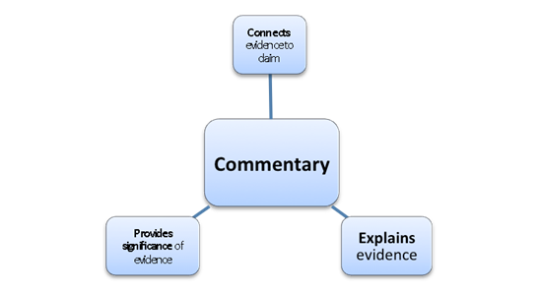
Commentary Competition
Remember:
Notes:
Small Group/Full Class

Slide 5
Commentary Competition
What do you believe are the characteristics of strong commentary?
How do you plan to write commentary without it becoming repetitive?
Notes:
Full Class

Slide 6
Commentary Competition
Page 44 & 45: In small groups of 3, rank the paragraphs in the Commentary Competition handout.
Notes:
As a class, review the rankings and discuss why groups made the decisions they made.

Slide 7
Commentary Competition
Review rankings and discuss why you made the decisions you made
Remember: Questions for Writing Commentary – Ask Yourself:
What do I need to make sure the reader understands about this evidence? (Re-explain the evidence.)
Why is this evidence especially important?
How does it prove and support the claim?
Notes:
As a class, review the rankings and discuss why groups made the decisions they made.

Slide 8
Practice Writing Complex Commentary
Pages 46 & 47 in groups 3
Notes:
Small Group

Slide 9
Practice Writing Complex Commentary
Share:
Exchange paragraphs and compare notes with another group.

Slide 10
Drafting Complex Commentary for Your Argument Paragraph
Revisit the commentary you wrote during the pre-writing phase (session 4)
Highlight or underline any sentences you think could be useful for this draft of the paragraph to prove the debatable claim and explain evidence.

Slide 11
Drafting Complex Commentary for Your Argument Paragraph
Revisit page 47: Drafting Commentary Anchor Chart - Strong Commentary Verbs
Use these verbs as you write commentary for your evidence.
acknowledges | compares | insists | claims
adds | confirms | notes | underscores
admits | declares | observes | exemplifies
agrees | denies | points outs | implies
argues | emphasizes | rejects | proves
asserts | highlights | reports | exhibits
believes | illustrates | responds | suggests

Slide 12
Drafting Complex Commentary for Your Argument Paragraph
Free write answers for the Drafting Commentary Anchor Chart – Complex Commentary Questions for each piece of evidence they have selected to support your argument.
Notes:
Circulate to assist students who have questions, to push individual student thinking further, and to read what students are writing. As you check in and/or conference with students, formatively assess their understanding of evidence and complex commentary using the rubric below.

