Slide 1
Writing the Argument
MAISA Unit
11 Sessions

Slide 2
1) Debatable Claim
An opinion that is a matter of personal experience and values that must be backed up with evidence. Others can disagree with this claim. Also known as opinion.

Slide 3
2) Evidence
Details, facts, and reasons that directly relate to and support a debatable claim.

Slide 4
3) Commentary
Sentences in an argument paragraph that explain what is important about the evidence and tell the reader how it proves and supports the claim – “So What?”

Slide 5
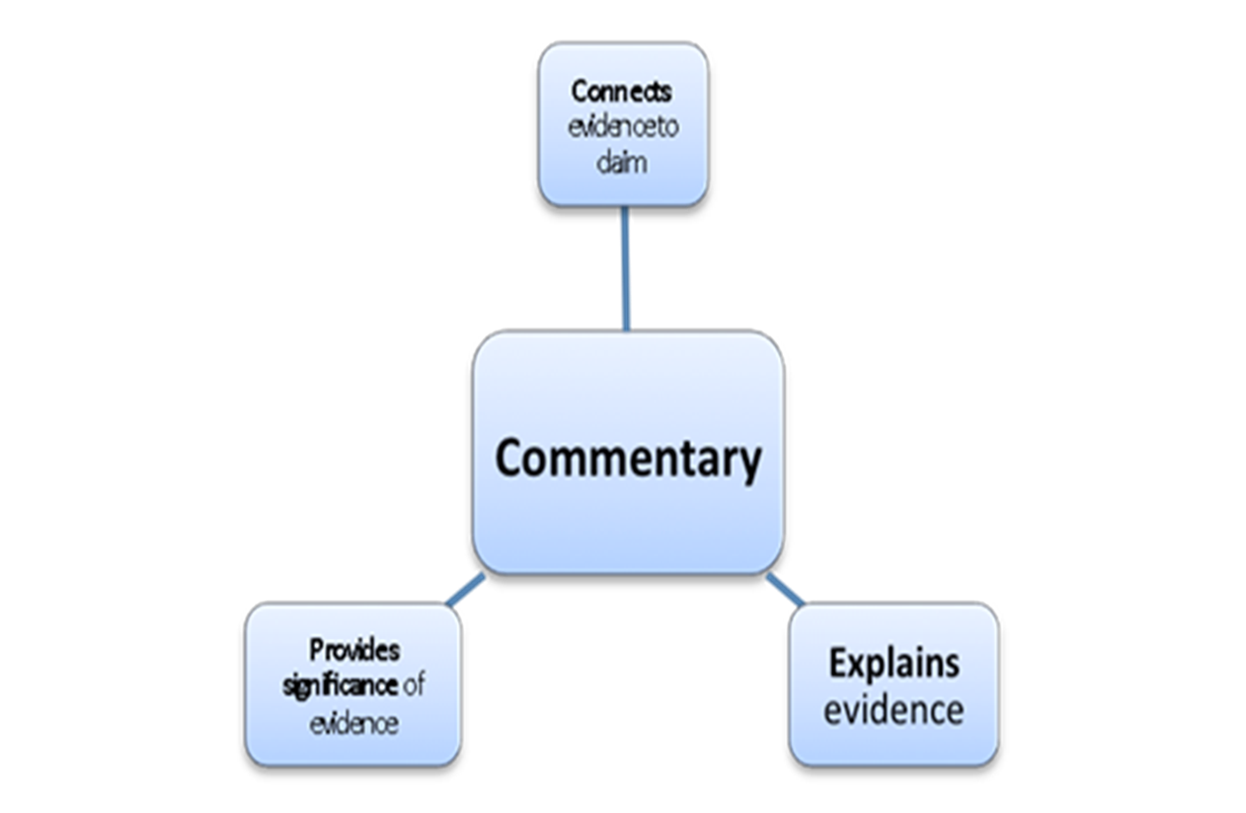

Slide 6
4) Argument
In life – conflicts that use language
In writing – opinions that can be backed up with evidence

Slide 7
5) Persuasion
To move another person or group to agree with a belief or position through argument, appeal, or course of action

Slide 8
So…to summarize
Claim = opinion on a topic
Evidence = facts, reasons, details
Commentary = explanation

Slide 9
6) Formula for Argument
Claim + Evidence+ Commentary = Argument

Slide 10
The BIG Idea
Develop a claim
Support it with evidence
Craft relevant commentary

Slide 11
Your Goal for This Unit
To write a strong argument paragraph

Slide 12
Purpose of a Paragraph
A group of sentences that focuses on a single idea.
The sentences are presented to the reader in a logical order so the reader understands the writer’s thinking.
Begins with a clear statement of what the paragraph will be about.

Slide 13
Video Clips about School Uniforms
Fill out the Analyzing Arguments graphic organizer while watching two different videos

Slide 14
Video Clips about School Uniforms
  http://www.youtube.com/watch?v=IjxgG7QNUQw&feature=related
- http://www.youtube.com/watch?v=0zpcBy2J7Dw

Slide 15
Video Clips about School Uniforms
    Name each video’s claim/stance.
    Define debatable claim using the Argument Concepts Anchor Chart.
    Name the reasons/evidence the videos provided.
      Which were most relevant and effective? How come?
    Define evidence using the Argument Concepts Anchor Chart.

Slide 16
Video Clips about School Uniforms
Assess how well the videos explained their evidence.
Define commentary using the Argument Concepts Anchor Chart.
Who had the more persuasive/convincing argument and why?

Slide 17
Fact vs. Opinion
What’s the difference between fact and opinion?
Notes:
Remind them that opinions are claims.

Slide 18
Here we go…
You are about to engage in an activity where you will make a claim and provide evidence and commentary to support that claim.
When you’ve finished recording your claims, evidence, and commentary, you’ll “vote with your feet” and share your arguments.

Slide 19
Students should be allowed to use cell phones at school. In a study at Yale University, Dr. Smith discovered that 74% of the student body had used their cell phone at least one time in the last calendar year for emergency purposes. This statistic is important because it proves that the majority of students needed access to their cell phone for an emergency while on campus.

Slide 20
Explain Your Argument
Complete the Explain Your Argument handout..
Notes:
You may want to do the first one together to model what the commentary looks like, as this will be challenging for some students

Slide 21
Vote with your feet

Slide 22
Commentary
How does commentary help persuade you?

